Slide 1
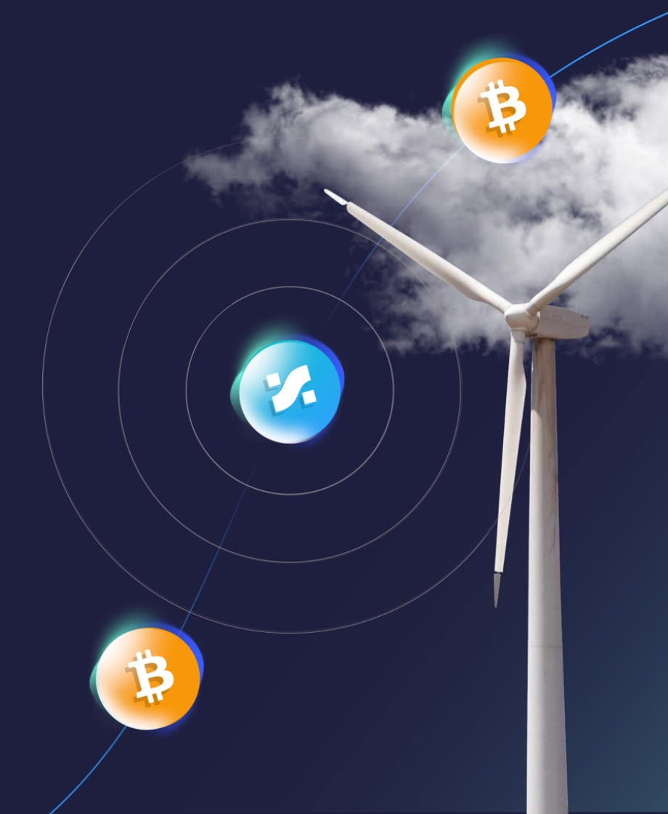

Mobilizing Bitcoin Capital
for the Energy Revolution
SBP Token: the only Energy Transition Asset derived from Bitcoin

Slide 2




Bitcoin is the World’s Most Scalable Clean Energy Buyer
Why aren’t climate aligned investors jumping from their seats to invest in Bitcoin?
There is no data layer to confirm that Bitcoin’s energy demand is driving gigawatts of renewables.
Yet $35 Trillion of Institutional Capital is mandated to invest in climate aligned investments.
💡 What would happen if Bitcoin’s clean energy data could be monetized?

Slide 3
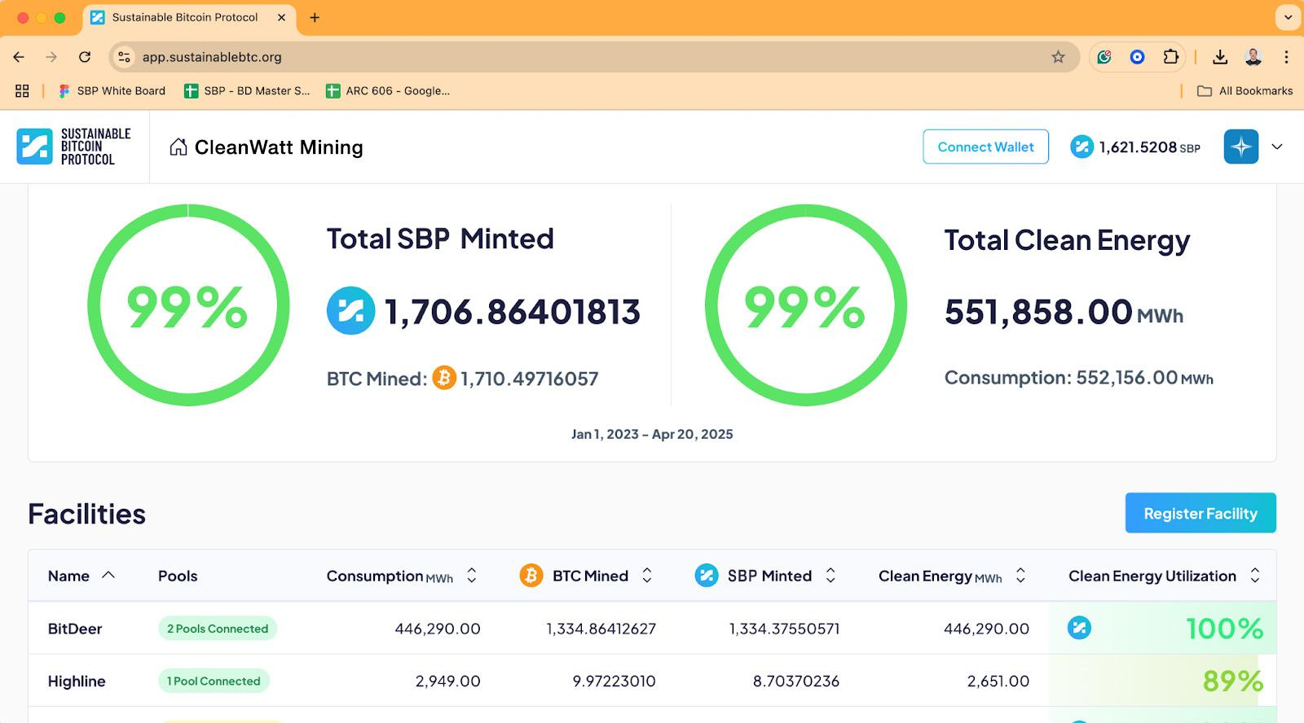
Infrastructure Powering
Verifiable Clean Energy Mining
Live platform with the leading Public, Sovereign & Private miners globally
Institutional‑grade sustainability layer
Largest Aggregator & Repository of Bitcoin Mining Energy data
18,000+ BTC verified backed by more than 7 Million MWh of verified energy data
✅Onchain proof that BTC was mined with verifiable clean energy.

Slide 4
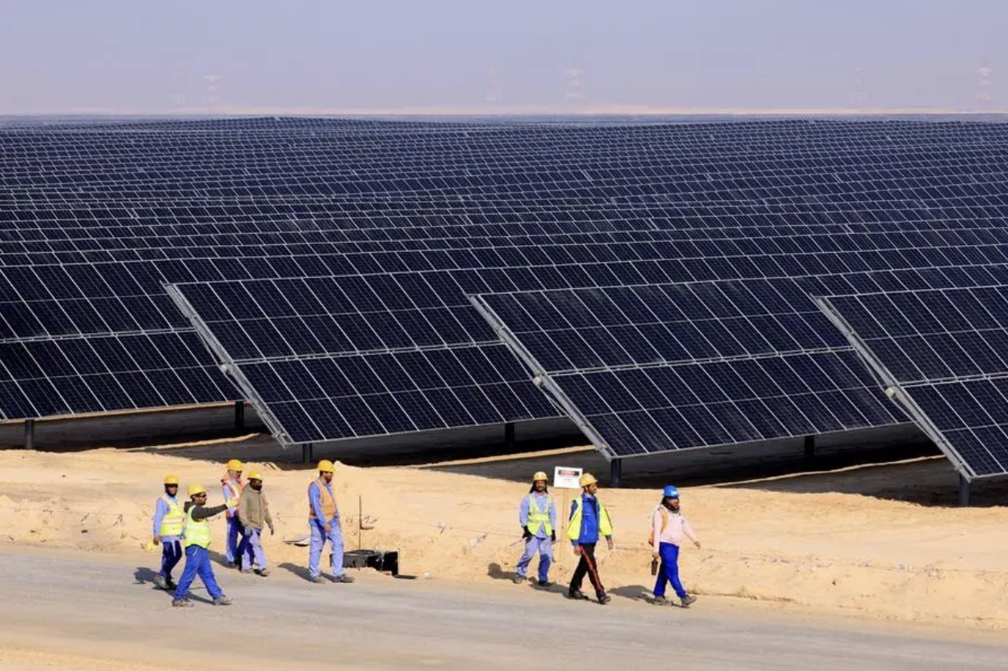
Al Dhafra, Abu Dhabi:
The Middle East’s Largest Solar Plant
7 Million MWh of verified clean energy purchased by BTC miners
3X the Annual Output of this facility
Bitcoin’s Next Big Use Case is to Finance the Energy Revolution

Slide 5

Built for Institutions
Powered by Clean Miners
23% of Global hashrate - Public, Sovereign & Private miners
⚡️ Clean mining now earns more.

Slide 6
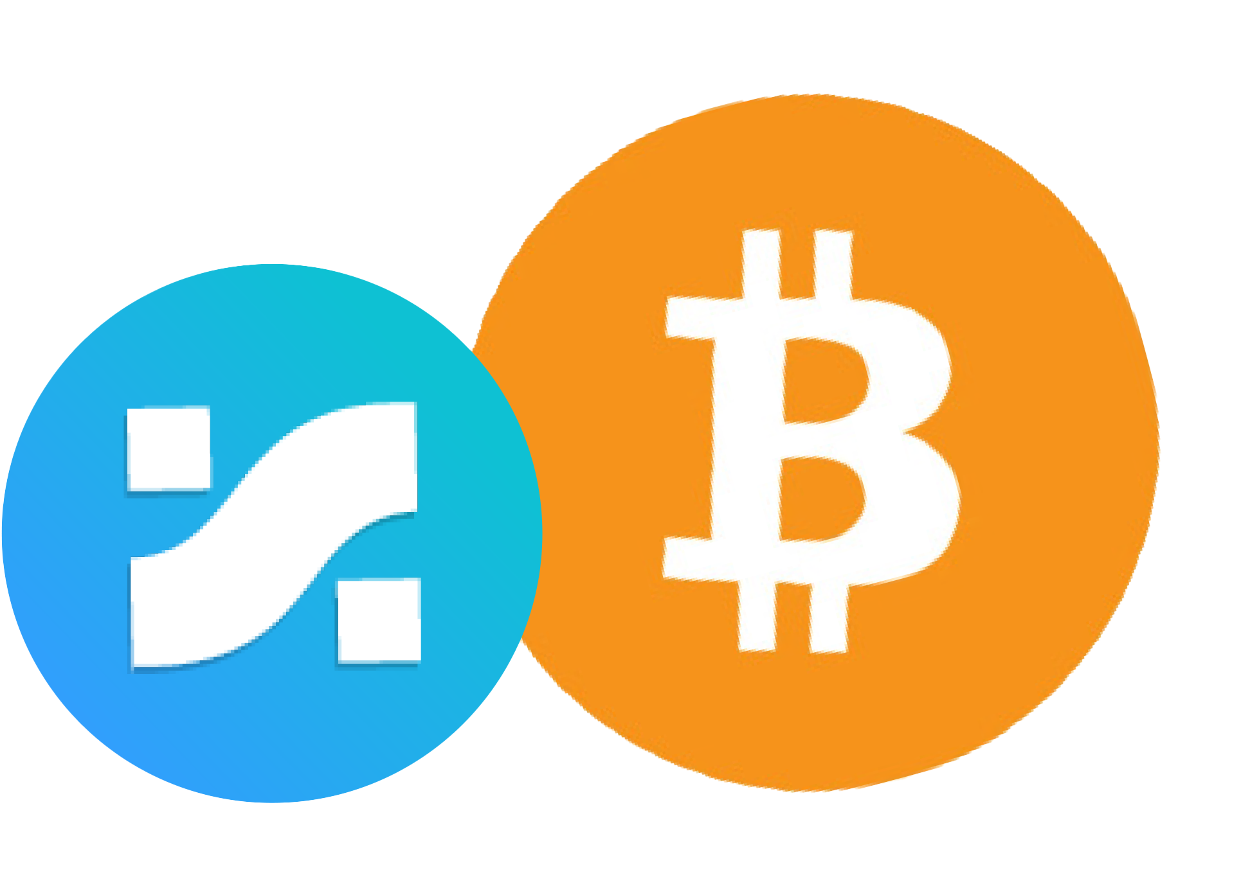
A Developing Ecosystem for Bitcoin‑Energy Transition Finance
Building New Institutional Investment Products:
Clean‑Wrapped BTC Tokenized proof‑of‑clean‑work BTC, ready for issuance by Zodia Custody, Coinbase and top custodians
Energy‑Transition Bitcoin ETFs Spot BTC + SBP ETFs in development with leading European and U.S. issuers
Structured Bitcoin Climate Finance Bitcoin collateralized lending and real world solar yield products built on verifiable clean‑work
🥇 The first digitally native, energy transition investments

Slide 7
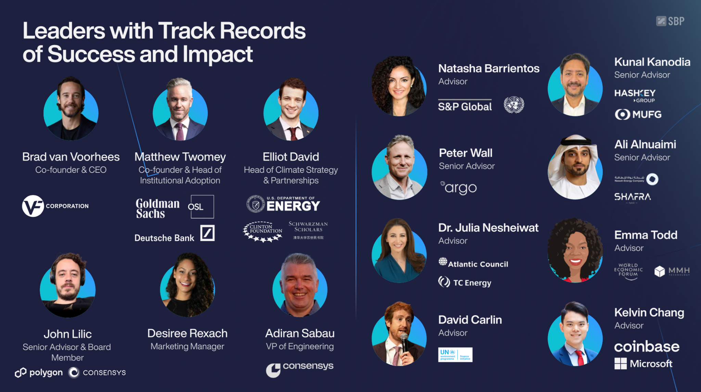

Slide 8


Join us to:
Ignite Bitcoin’s Potential to Finance The Energy Revolution
Welcome the first $1 Trillion of Climate Aligned Capital to Bitcoin
www.sustainablebtc.org

